Slide 1
RouterLink

Slide 2
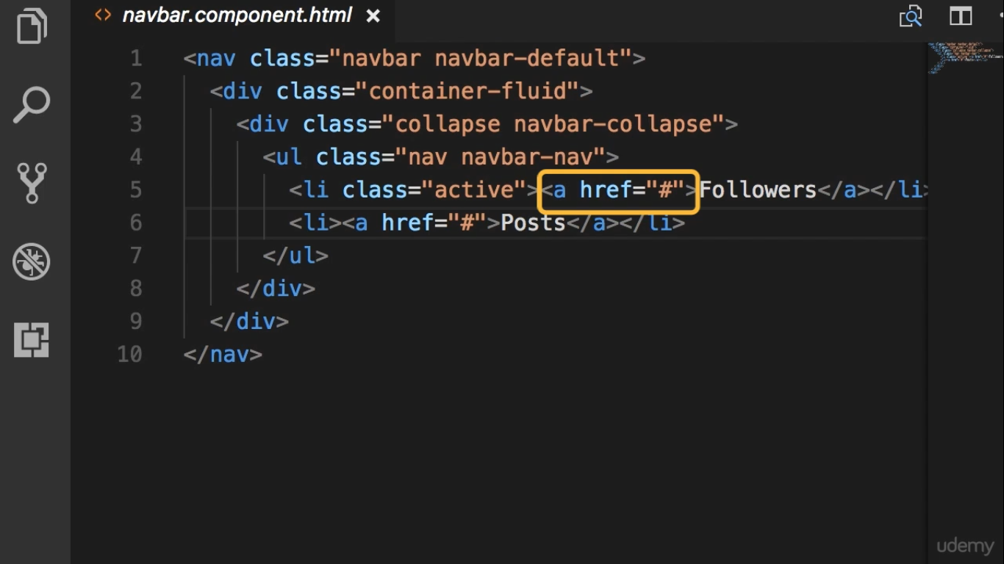

Slide 3
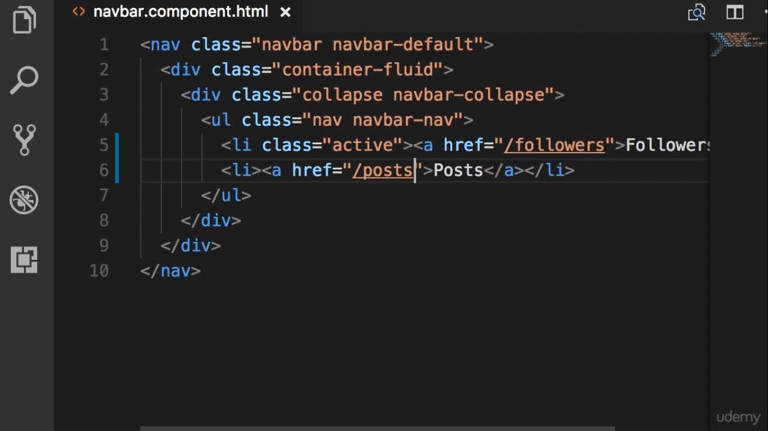
When we use href attribute,
the entire page is downloaded and the angular app is reinitialize

Slide 4
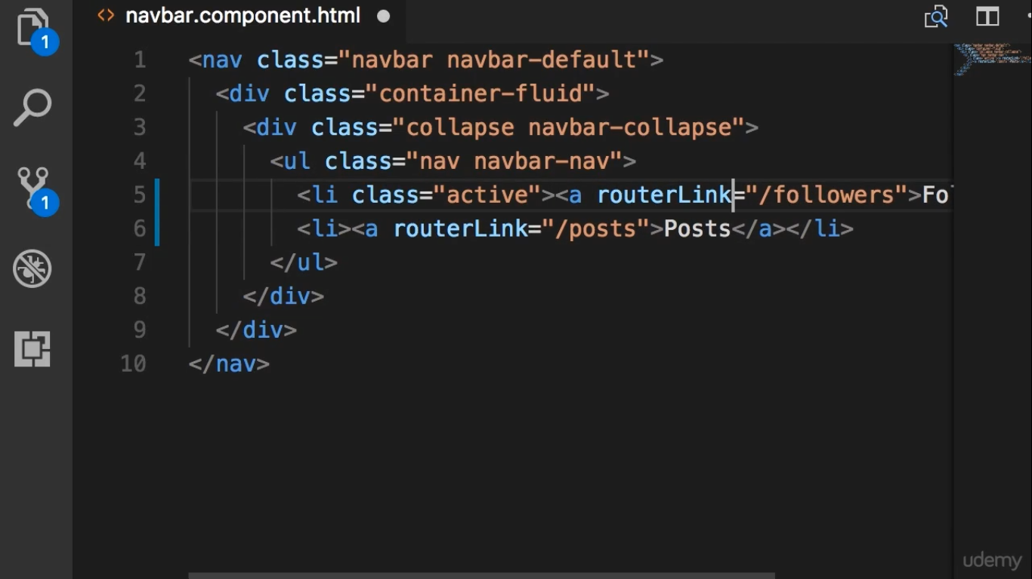
When we click link,
we want only the content for the new page to be downloaded

Slide 5
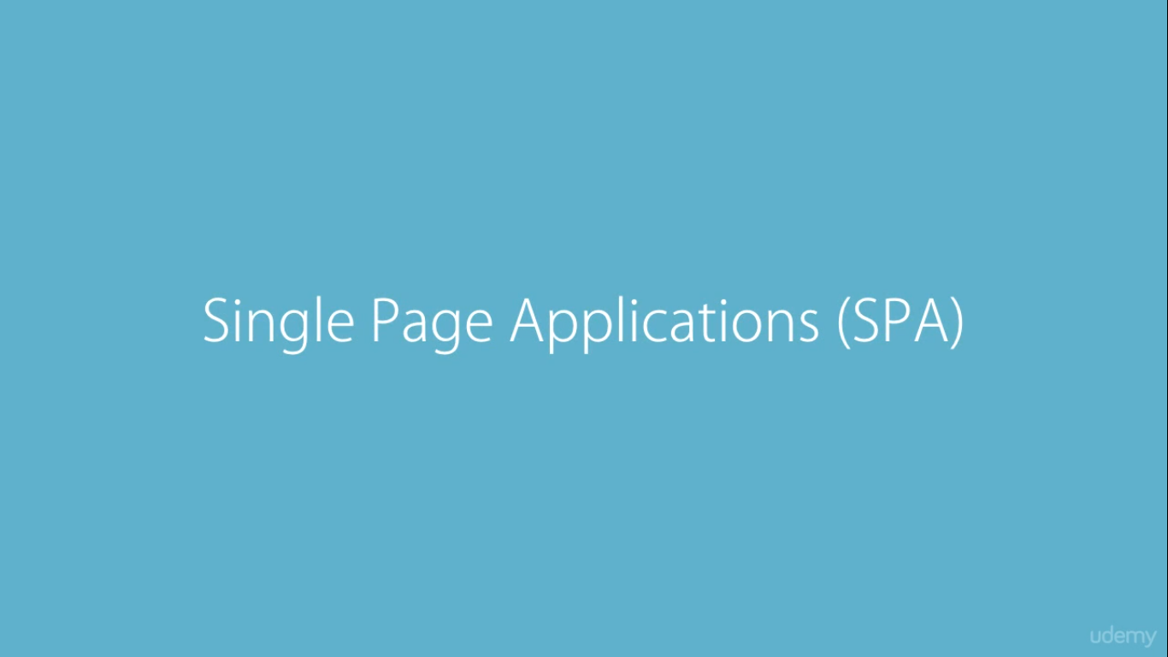

Slide 6
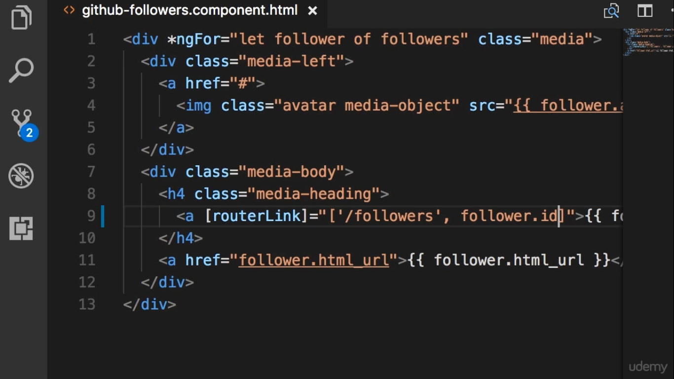

Slide 7
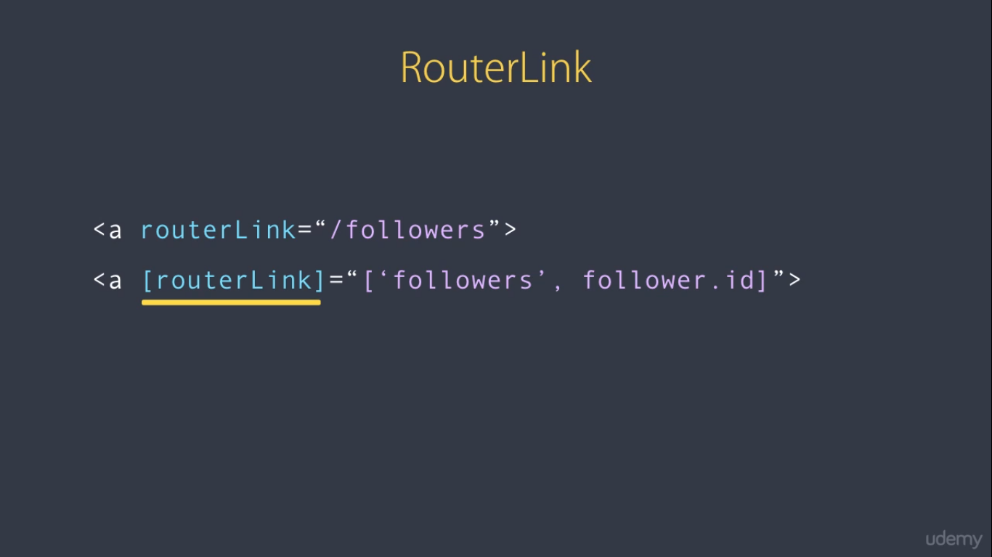
Property binding

Slide 8
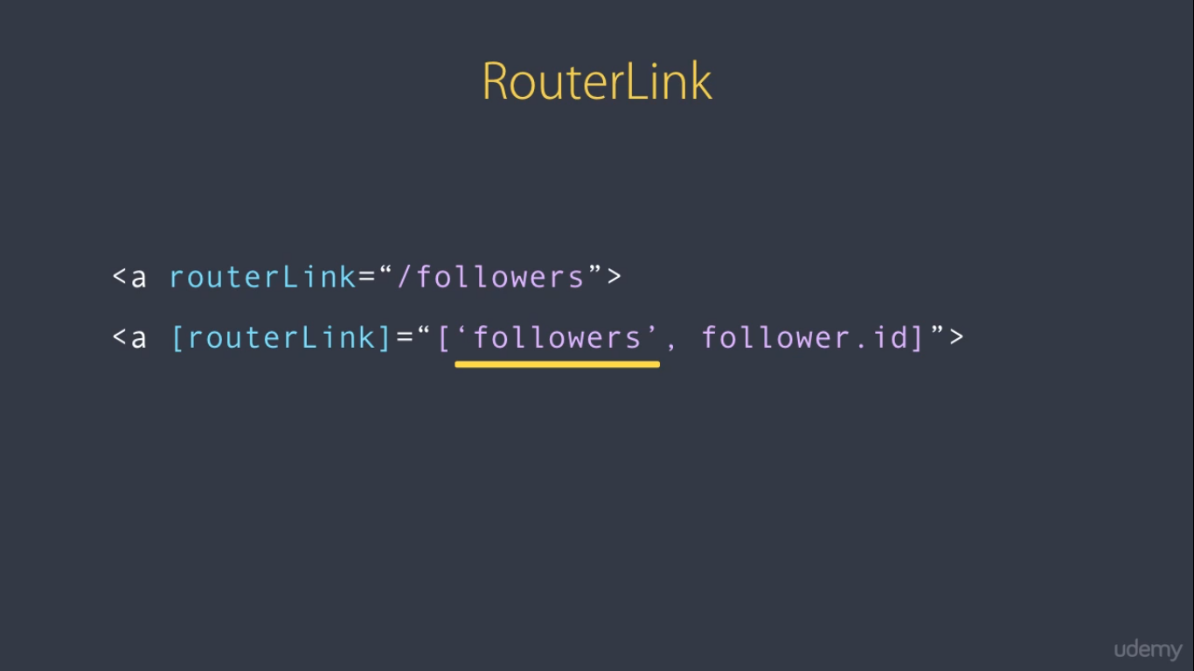
Path

Slide 9
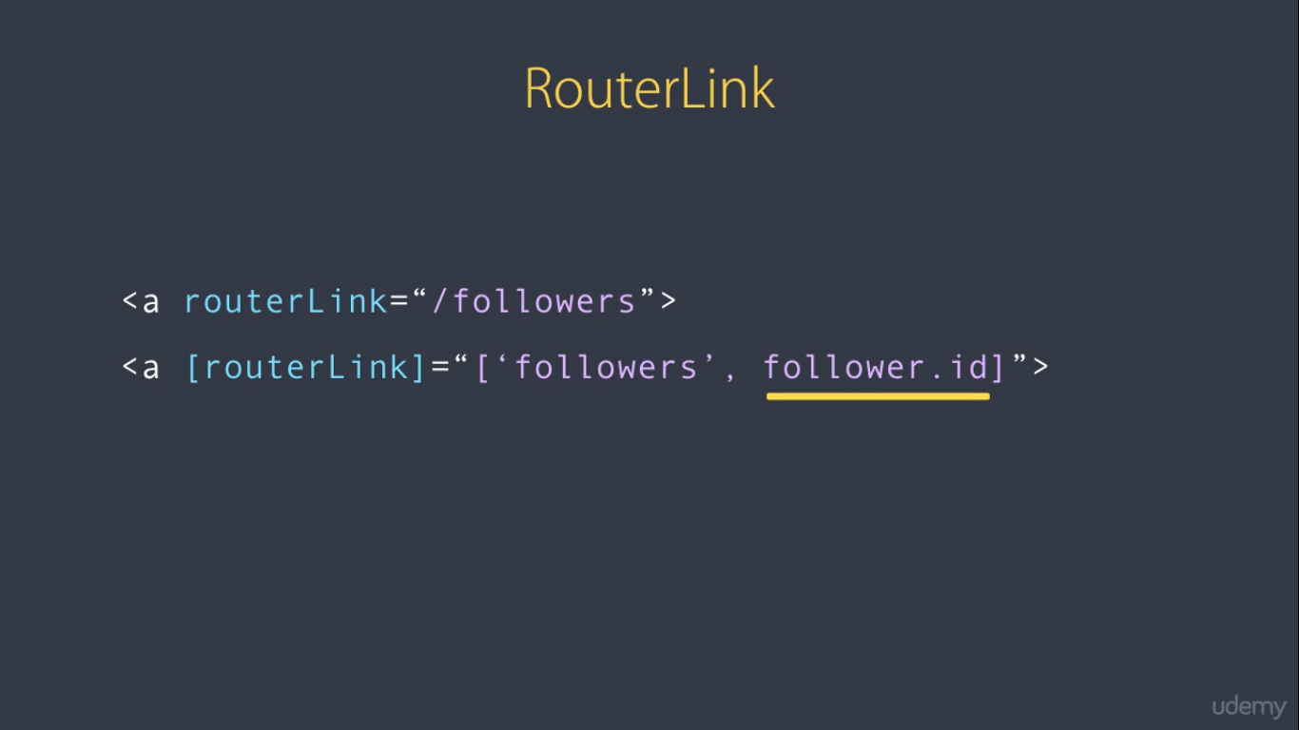
Route Arguments

